Slide 1
Arrays

Slide 2
Arrays
Array is a collection of similar data types in which each element is unique and located in contiguous memory locations.

Slide 3
Arrays
The values held in an array are called array elements
An array stores multiple values of the same type – the element type
we can create an array of integers, an array of characters, an array of String objects, an array of Coin objects, etc.

Slide 4
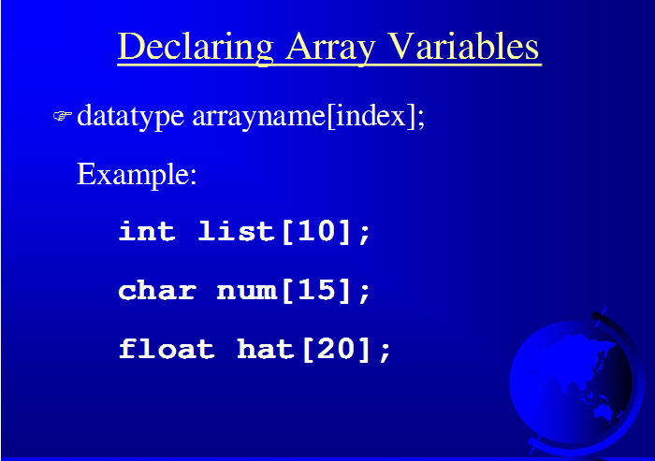

Slide 5
Arrays
A particular value in an array is referenced using the array name followed by the index in brackets
For example, the expression
scores[2]
refers to the value 94 (the 3rd value in the array)
That expression represents a place to store a single integer and can be used wherever an integer variable can be used

Slide 6
Arrays
An array is an ordered list of values
The entire array
has a single name
Each value has a numeric index
0 1 2 3 4 5 6 7 8 9
scores
79 87 94 82 67 98 87 81 74 91
An array of size N is indexed from zero to N-1
This array holds 10 values that are indexed from 0 to 9

Slide 7
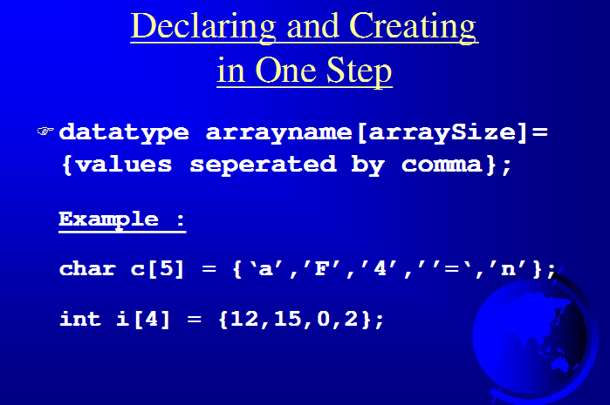

Slide 8
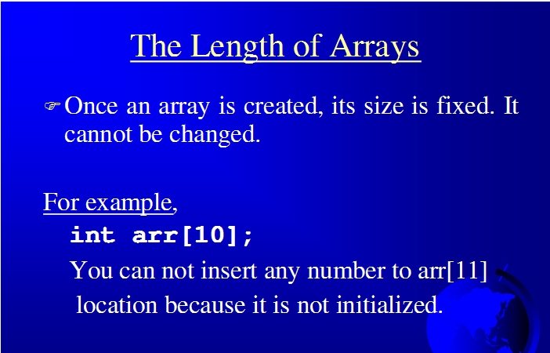

Slide 9
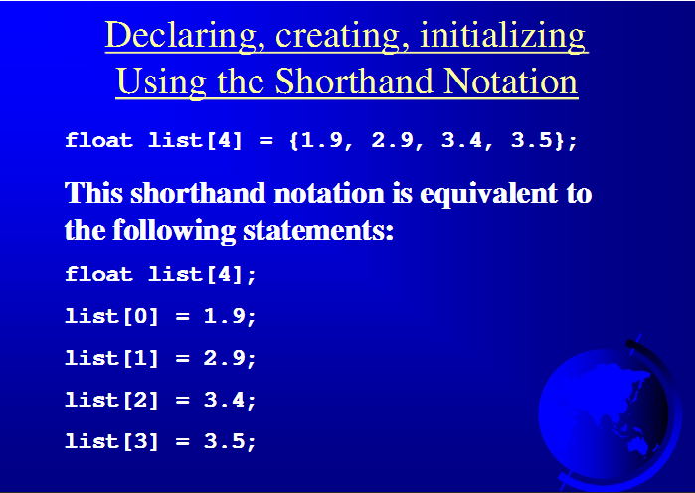

Slide 10
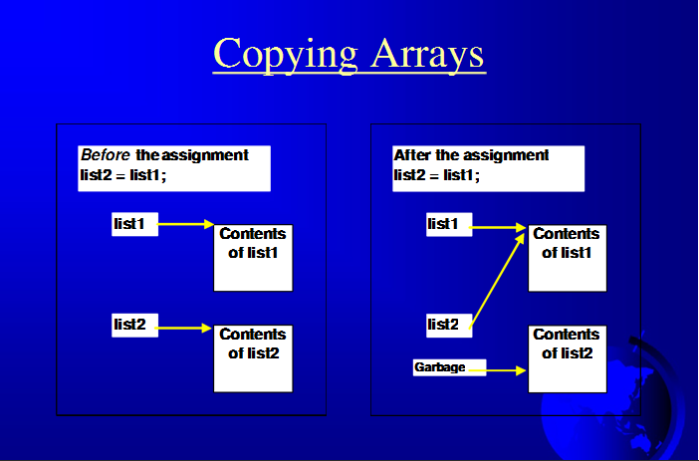

Slide 11
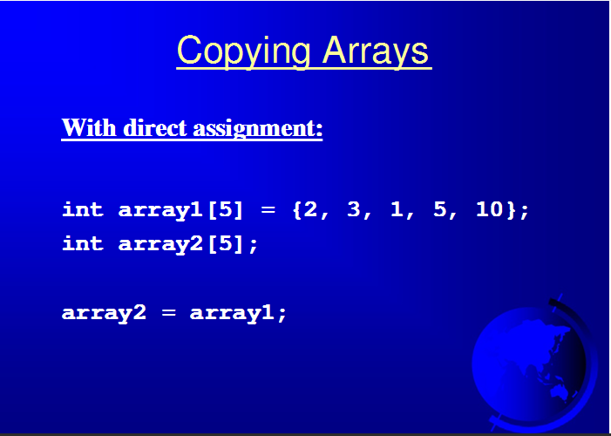

Slide 12

1-dimensional array
A one dimensional array is a list of data values, with all values having the same data type(the base type), such as:
integer
float
double
char
Technically, an array is a uniform data structure. Individual array elements are referenced using the array name and a subscript that identifies the element position in the array.
15-<number>

Slide 13
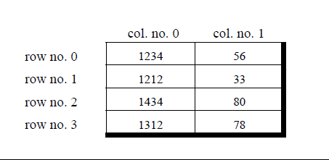
Multidimensional array

Slide 14
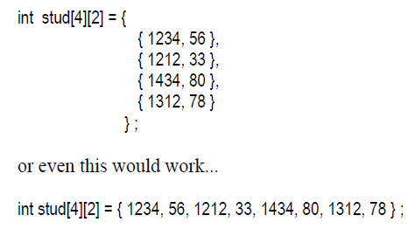
Initialization of 2-D Array

Slide 15
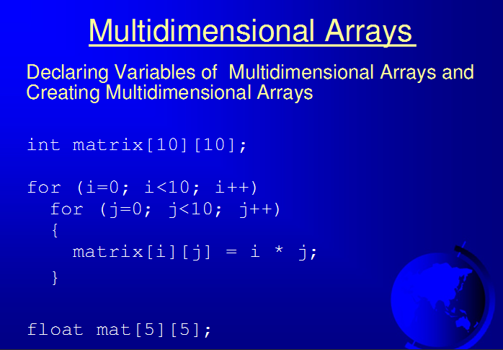

Slide 16
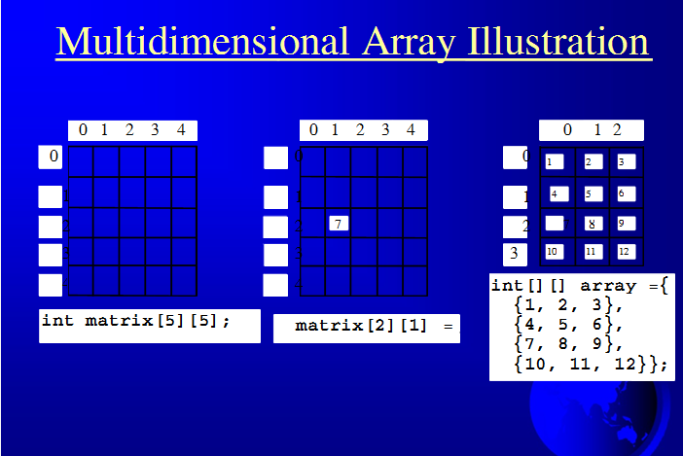

Slide 17
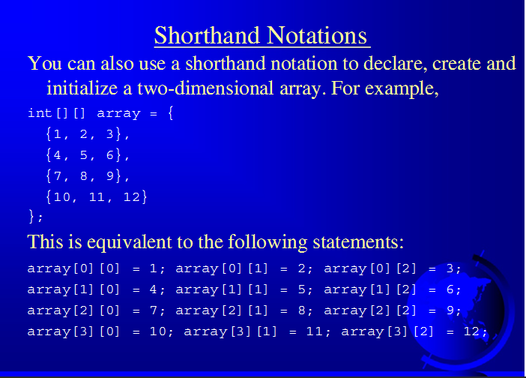

Slide 18

Character Arrays
We will implement strings in C by using a one dimensional array of characters
the last character is the “NULL” character ‘\0’.
In C, you must always terminate a character array with the NULL character, ‘\0’ . Therefore, the array size of your character array should be one plus the maximum length of the string you want to store.
Example: In the declaration
char atomic[ ] = "hydrogen";
“atomic” is an array of nine elements, the last being ‘\0’
15-<number>

Slide 19
Declaring a Character Array
Declaring a string array with character constants
char aString[ ] = {'Z', 'i', 'p', '!‘, '\0'};
Declaring character arrays with a string constant
char aString[5] = "Zip!";
char atomic[ ] = "hydrogen";
15-<number>

Slide 20
Passing Arrays as Function Arguments
C++ does not allow to pass an entire array as an argument to a function. However, You can pass a pointer to an array by specifying the array's name without an index.
If you want to pass a single-dimension array as an argument in a function, you would have to declare function formal parameter.

Slide 21
Formal parameters as a pointer as follows:
void myFunction(int *param)
{
. . .
}
Formal parameters as a sized array as follows:
void myFunction(int param[10])
{
. . .
}

Slide 22
Formal parameters as an unsized array as follows:
void myFunction(int param[])
{
. . .
}

